Slide 1
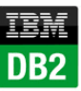
IBM DB2

Slide 2
OVERVIEW.....
INTRODUCTION.
HISTORY.
VERSIONS.
FEATURES.
VARIOUS BUILT IN DATA TYPES.
DATABASE ARCHITECTURE.
BACKUP AND RECOVERY.
COMPARISON.

Slide 3
WHAT IS IBM DB2 ?
DB2 is a database product from IBM. It is a Relational Database Management System (RDBMS).
DB2 is designed to store, analyze and retrieve the data efficiently. DB2 product is extended with the support of Object-Oriented features and non-relational structures with XML(extensible markup language).

Slide 4
HISTORY.......
Initially, IBM had developed DB2 product for their specific platform.
Since year 1990, it decided to develop a Universal Database (UDB) DB2 Server, which can run on any authoritative operating systems such as Linux, UNIX, and Windows.

Slide 5
VERSIONS........
For IBM DB2, the UDB current version is 10.5 with the features of BLU Acceleration and its code name as 'Kepler'. All the versions of DB2 till today are listed below :
Version Code Name
3.4 Cobweb
8.1, 8.2 Stinger
9.1 Viper
9.5 Viper 2
9.7 Cobra

Slide 6
Data server editions and features……..
Depending upon the requirement of needful features of DB2, the organizations select appropriate DB2 version. The following table shows DB2 server editions and their features:

Slide 7
EDITION
FEATURES
Advanced Enterprise Server Edition and Enterprise Server Edition (AESE / ESE)
It is designed for mid-size to large-size business organizations.
Platform - Linux, UNIX, and Windows. Table partitioning High Availability Disaster Recovery (HARD) Materialized Query Table (MQTs) Multidimensional Clustering (MDC) Connection concentrator Pure XML Backup compression Homogeneous Federations.

Slide 8
EDITION
FEATURES
Workgroup Server Edition (WSE)
It is designed for Workgroup or mid-size business organizations.
Using this WSE you can work with - High Availability Disaster Recovery (HARD) Online Reorganization Pure XML Web Service Federation support DB2 Homogeneous Federations Homogeneous SQL replication Backup compression

Slide 9
EDITION
FEATURES
Express –C
Express Edition
It provides all the capabilities of DB2 at zero charge. It can run on any physical or virtual systems with any size of configuration.
It is designed for entry level and mid-size business organizations.
It is full featured DB2 data server. It offers only limited services.
This Edition comes with - Web Service

Slide 10
VARIOUS BUILT IN DATA TYPES......
Datetime
TIME: It represents the time of the day in hours, minutes and seconds.
TIMESTAMP: It represents seven values of the date and time in the form of year, month, day, hours, minutes, seconds and microseconds.
DATE: It represents date of the day in three parts in the form of year, month and day.
String
Character
CHAR (fixed length): Fixed length of Character strings.
Varying length
VARCHAR: Varying length character strings.
CLOB: large object strings, you use this when a character string might exceed the limits of the VARCHAR data type.

Slide 11
Binary integer
SMALLINT [16BIT]: Using this you can insert small int values into columns
INTEGER [32BIT]: Using this you can insert large int values into columns
BIGINT [64BIT]: Using this you can insert larger int values into columns
Decimal
DECIMAL (packed)
DECFLOAT (decimal floating point): Using this, you can insert decimal floating point numbers
Approximate

Slide 12
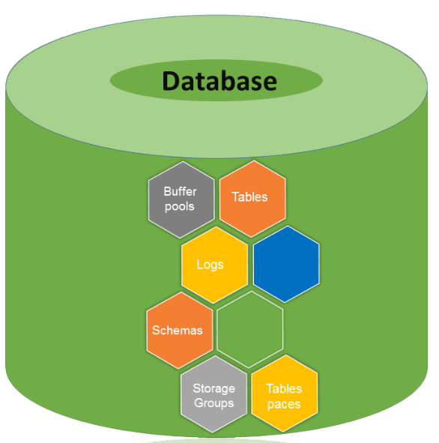
DATABASE DIRECTORY.......

Slide 13
AS IT IS VERY CLEAR FROM THE ABOVE SLIDE THAT THE ARCHITECTURE OF THIS DATABASE HAS THE FOLLOWING CONTENTS :
BUFFER POOLS
TABLES
LOGS
SCHEMAS
STORAGE GROUPS
TABLE SPACES

Slide 14
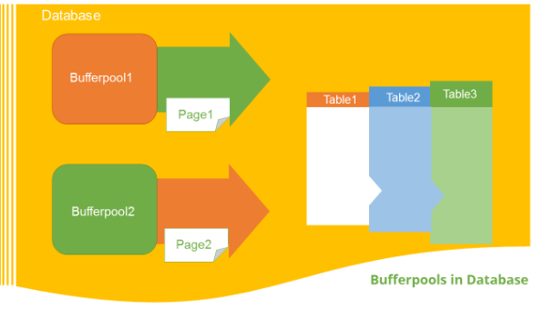
Bufferpools.....

Slide 15
BUFFER POOLS...
The bufferpool is portion of a main memory space which is allocated by the database manager. The purpose of bufferpools is to cache table and index data from disk. All databases have their own bufferpools. A default bufferpool is created at the time of creation of new database. It called as “IBMDEFAULTBP”.
Depending on the user requirements, it is possible to create a number of bufferpools. In the bufferpool, the database manager places the table row data as a page. This page stays in the bufferpool until the database is shutdown or until the space is written with new data.

Slide 16
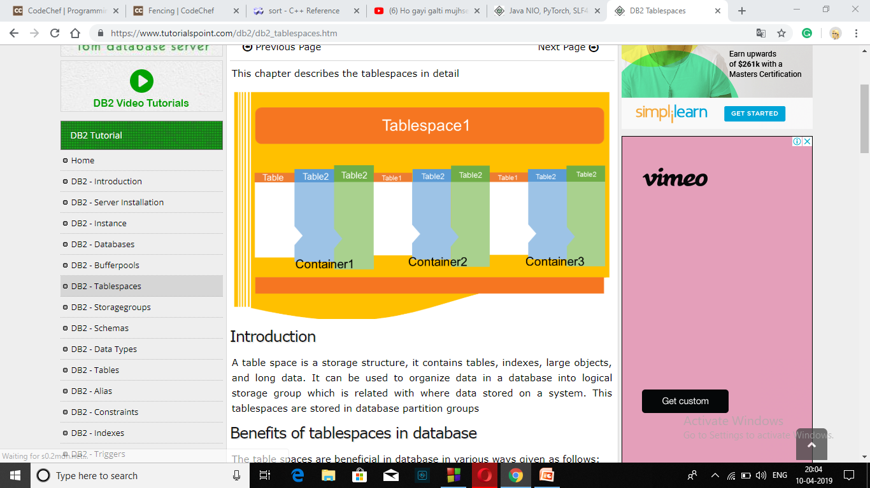
Tables.......

Slide 17
TABLES...
Tables are logical structure maintained by Database manager. In a table each vertical block called as column (Tuple) and each horizontal block called as row (Entity). The collection of data stored in the form of columns and rows is known as a table.
Type of tables
Base Tables: They hold persistent data.
Temporary Tables: For temporary work of different database operations, you need to use temporary tables. The temporary tables (DGTTs) do not appear in system catalog.
Materialized Query Tables: MQT can be used to improve the performance of queries. These types of tables are defined by a query, which is used to determine the data in the tables.

Slide 18
Creating Tables………
Syntax.......
db2 create table <schema_name>.<table_name> (column_name column_type....) in <tablespace_name>
For example........ We create a table to store “employee” details in the schema of “professional”. This table has “id, name, jobrole, joindate, salary” fields and this table data would be stored in tablespace “ts1”.
db2 create table professional.employee(id int, name varchar(50),jobrole varchar(30),joindate date, salary double) in ts1

Slide 19
Tablespace.....

Slide 20
TABLESPACES...
A table space is a storage structure, it contains tables, indexes, large objects, and long data. It can be used to organize data in a database into logical storage group which is related with where data stored on a system. This tablespaces are stored in database partition groups.
Benefits of tablespaces in database :
Recoverability
Automatic storage Management
Memory utilization

Slide 21
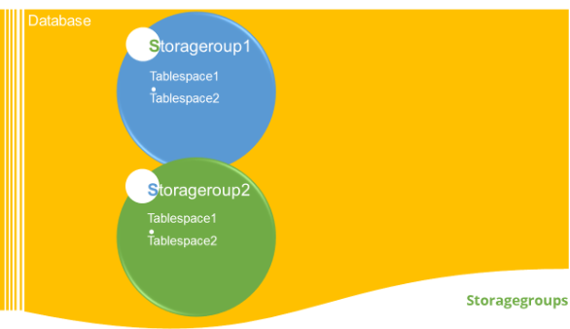
Storage spaces....

Slide 22
STORAGE SPACES...
A set of Storage paths to store database table or objects, is a storage group. You can assign the tablespaces to the storage group. When you create a database, all the tablespaces take default storage group. The default storage group for a database is ‘IBMSTOGROUP’ .
Listing storagegroups :
You can list all the storagegroups in the database.
Syntax: [To see the list of available storagegroups in current database]
db2 select * from syscat.stogroups
Example: [To see the list of available storagegorups in current database]
db2 select * from syscat.stogroups

Slide 23
Creating a storagegroup…….
Here is a syntax to create a storagegroup in the database:
Syntax: [To create a new stogroup. The ‘stogropu_name’ indicates name of new storage group and ‘path’ indicates the location where data (tables) are stored]
db2 create stogroup on ‘path’
Example: [To create a new stogroup ‘stg1’ on the path ‘data1’ folder]
db2 create stogroup stg1 on ‘/data1’

Slide 24
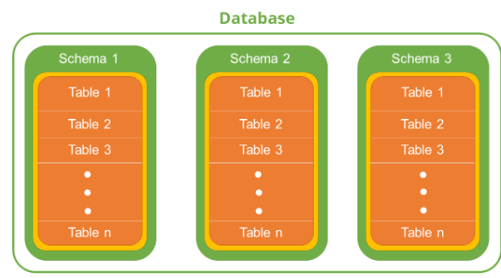
Schemas.....

Slide 25
SCHEMAS...
A schema is a collection of named objects classified logically in the database.
In a database, you cannot create multiple database objects with same name. To do so, the schema provides a group environment. You can create multiple schemas in a database and you can create multiple database objects with same name, with different schema groups.
Getting currently active schema
Syntax:
db2 get schema
Example: [To get current database schema]
db2 get schema

Slide 26
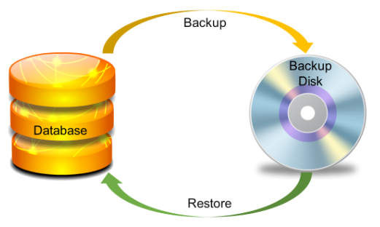
BACKUP AND RECOVERY...
FOLLLOWING ARE THE VARIOUS METHODS FOR THE BACKUP AND RECOVERY WHICH ARE USED IN BACKUP AND RECOVERY PROCESS.

Slide 27
Backup and recovery methods are designed to keep our information safe.
THE LOGGING TECHNIQUE IS USED FOR THE RECOVERY METHOD :
It is of further two types :
1. CIRCULAR LOGGING.
2. ARCHIVE LOGGING.

Slide 28
CIRCULAR LOGGING.......
It is a method where the old transaction logs are overwritten when there is a need to allocate a new transaction log file, thus erasing the sequences of log files and reusing them. You are permitted to take only full back-up in offline mode i.e., the database must be offline to take the full backup.

Slide 29
ARCHIVE LOGGING........
This mode supports for Online Backup and database recovery using log files called roll forward recovery. The mode of backup can be changed from circular to archive by setting log retain or user exit to ON. For archive logging, backup setting database require a directory that is writable for DB2 process.

Slide 30
Backup……
Using Backup command you can take copy of entire database. This backup copy includes database system files, data files, log files, control information and so on.
You can take backup while working offline as well as online.

Slide 31
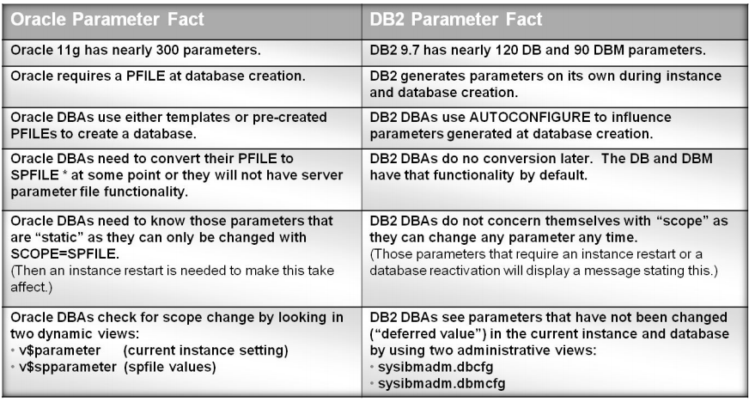
COMAPARISON btw Oracle & db2..

Slide 32

Thank u....

